Slide 1
Stock Price Prediction and Portfolio Optimization using Deep Learning
Ritvik Dhupkar

Slide 2
Introduction
Fluctuations in Stock Prices due to difference in the Short, Medium and long term time frame
Short Run- Fluctuations and price determined by market Dynamics,
Dynamics of Order Executions. Scale of Milliseconds
Medium Term- Fluctuations determined by news cycles. Scaler of Days
Long Term- fluctuations determined by fundamental financial performance of the company. In the long run Stocks believed to converge to the ‘Intrinsic Value’ of the Company.

Slide 3
Introduction
2 Parts (A&B)
Part A: Using Financial Fundamentals (P/E Ratio, Assets, etc.) in combination with Deep Learning methods to predict returns and create an investment Strategy
Part B: Using Portfolio Strategies from Fundamental Finance to develop an investment Strategy in combination with DL

Slide 4
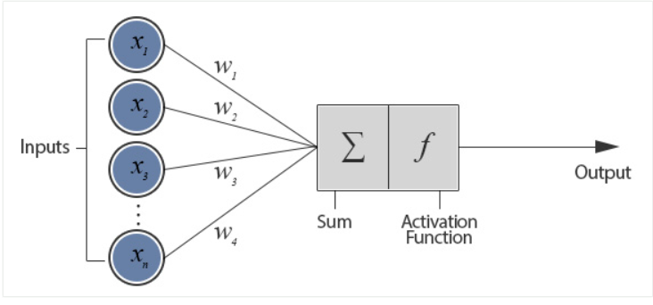
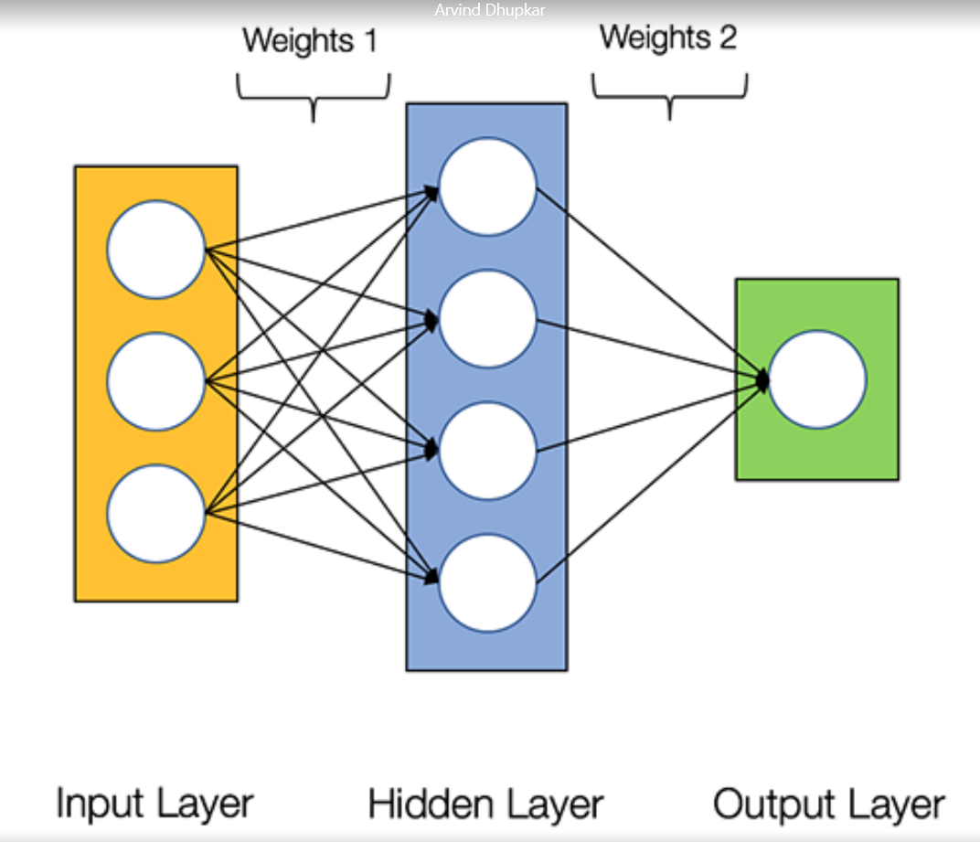
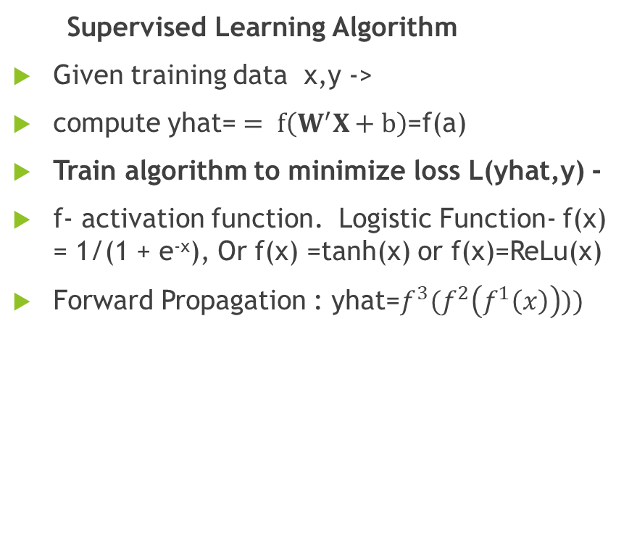
Introduction on Neural Networks
Supervised Learning Algorithm
Given training data x,y ->
compute yhat= $= f\left(W^{′}X+b\right)$=f(a)
Train algorithm to minimize loss L(yhat,y) -
f- activation function. Logistic Function- f(x) = 1/(1 + e^{-x}), Or f(x) =tanh(x) or f(x)=ReLu(x)
Forward Propagation : yhat=$f^{3}(f^{2}\left(f^{1}\left(x\right)\right)))$
Perceptron

Slide 5

Loss Function with Regularization
$L\left(y_{hat},y\right) : loss function$
$Ω\left(θ\right):$ Regularization parameter
$θ:vector consisting of w,b$
Cost Function: $J=L\left(y_{hat},y\right)+λΩ(θ)$

Slide 6
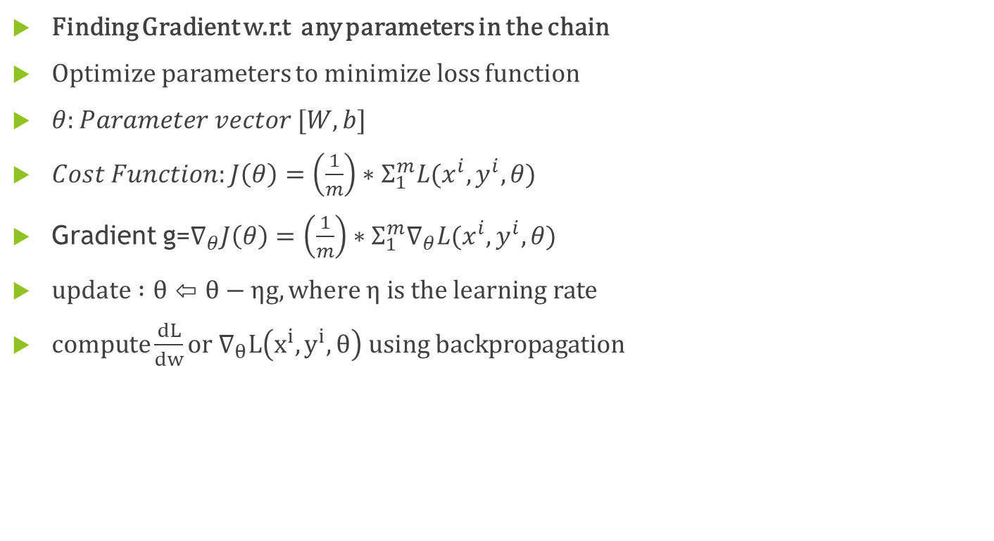
Gradient Descent:
Finding Gradient w.r.t any parameters in the chain
Optimize parameters to minimize loss function
$θ:Parameter vector [W,b]$
$Cost Function:J\left(θ\right)=\left(\frac{1}{m}\right)∗Σ_{1}^{m}L(x^{i},y^{i},θ)$
Gradient g=$∇_{θ}J\left(θ\right)=\left(\frac{1}{m}\right)∗Σ_{1}^{m}∇_{θ}L(x^{i},y^{i},θ)$
$update :θ⇦θ−ηg, where η is the learning rate$
$compute\frac{dL}{dw}or ∇_{θ}L\left(x^{i},y^{i},θ\right) using backpropagation$

Slide 7
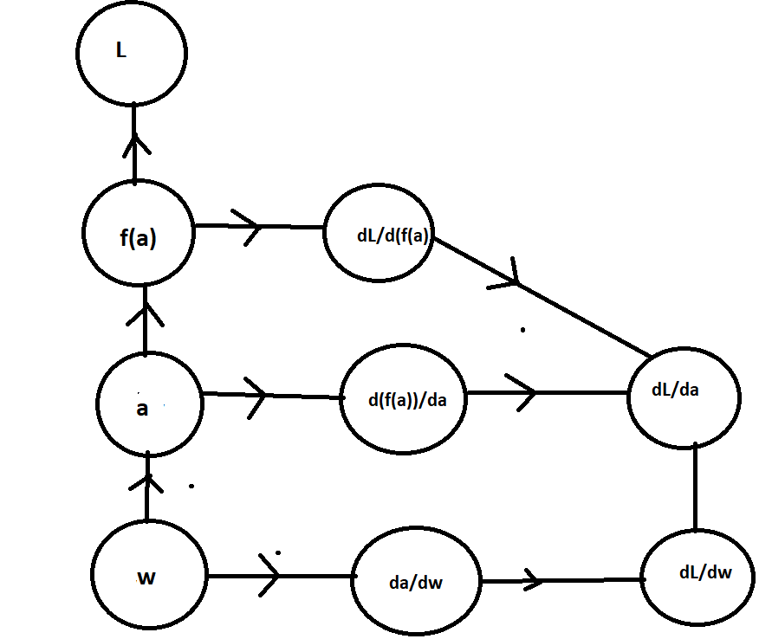
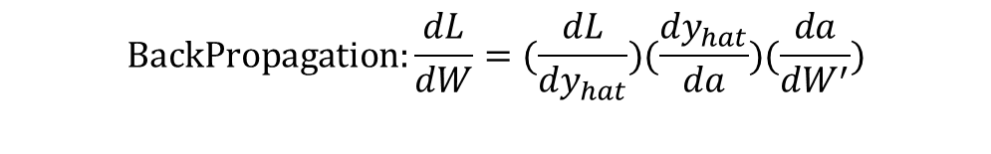
Backpropagation
$$BackPropagation:\frac{dL}{dW}=(\frac{dL}{{dy}_{hat}})(\frac{{dy}_{hat}}{da})(\frac{da}{{dW}^{′}})$$

Slide 8
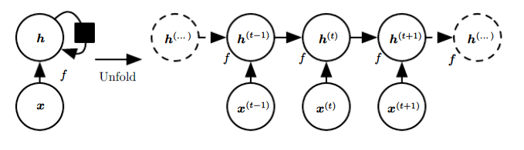
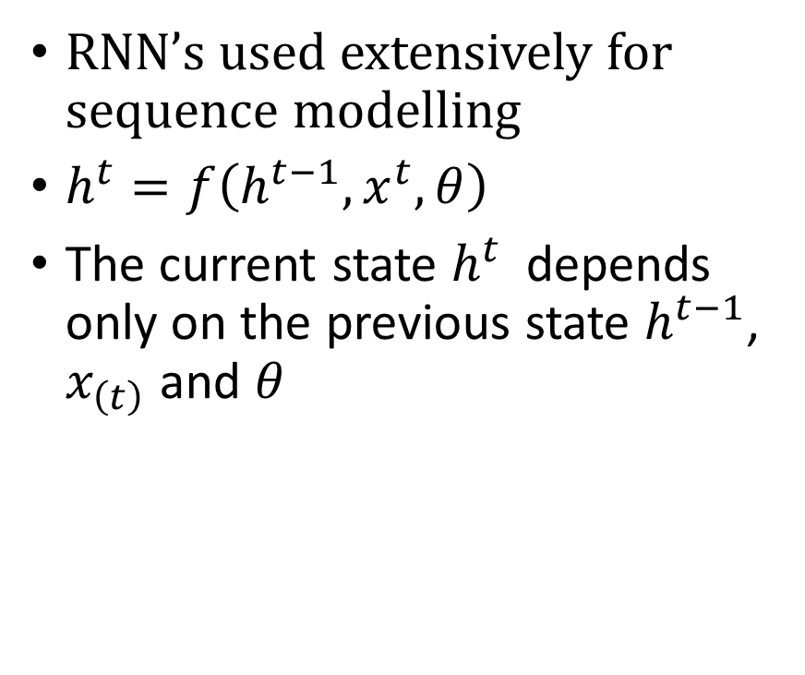
Recurrent Neural Networks
RNN’s used extensively for sequence modelling
$h^{t}=f\left(h^{t−1},x^{t},θ\right)$
The current state $h^{t}$ depends only on the previous state $h^{t−1}$, $x_{\left(t\right)}$ and $θ$
RNN with no Output (Deep Learning, Ian Goodfellow)

Slide 9
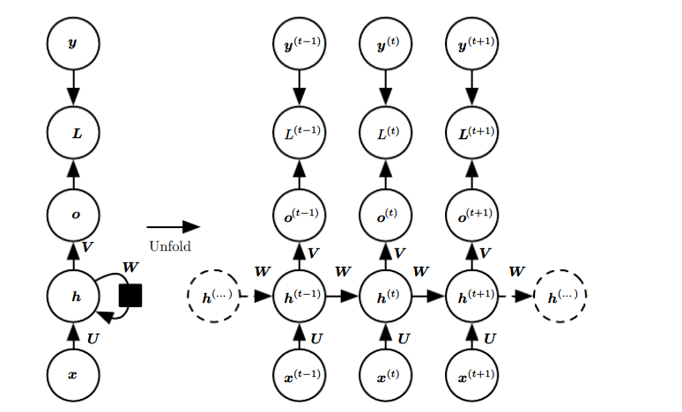
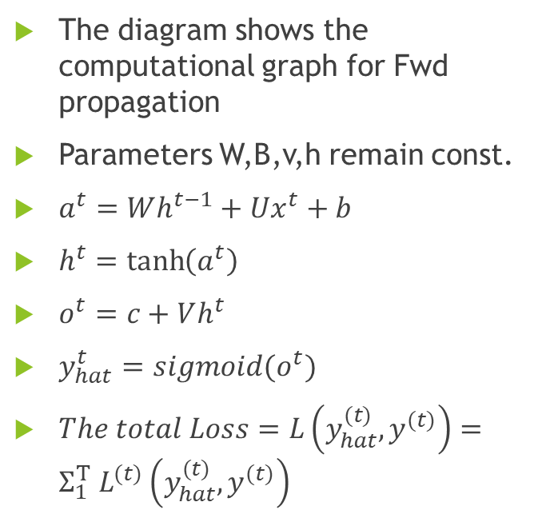
Forward Propagation of RNN
The diagram shows the computational graph for Fwd propagation
Parameters W,B,v,h remain const.
$a^{t}=Wh^{t−1}+Ux^{t}+b$
$h^{t}=\tanh\left(a^{t}\right)$
$o^{t}=c+Vh^{t}$
$y_{hat}^{t}=sigmoid(o^{t})$
$The total Loss=L\left(y_{hat}^{(t)},y^{(t)}\right)=Σ_{1 }^{T}L^{(t)}\left(y_{hat}^{(t)},y^{(t)}\right)$

Slide 10
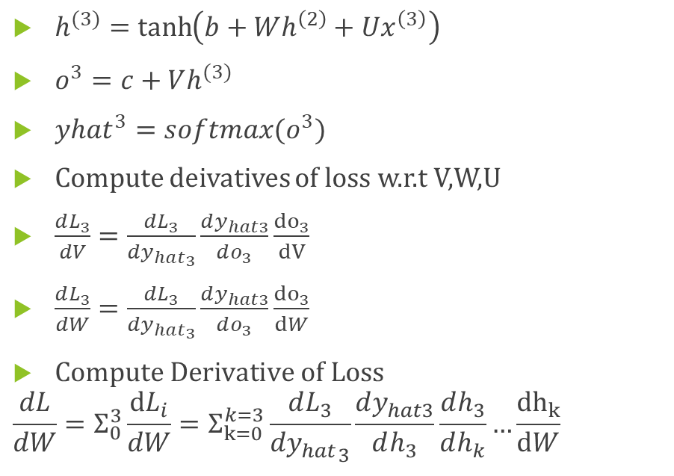
Backpropagation Through Time
$h^{(3)}=\tanh\left(b+Wh^{\left(2\right)}+Ux^{\left(3\right)}\right)$
$o^{3}=c+Vh^{(3)}$
${yhat}^{3}=softmax(o^{3})$
Compute deivatives of loss w.r.t V,W,U
$\frac{dL_{3}}{dV}=\frac{dL_{3}}{d{y_{hat}}_{3}}\frac{dy_{hat3}}{do_{3}}\frac{{do}_{3}}{dV}$
$\frac{dL_{3}}{dW}=\frac{dL_{3}}{d{y_{hat}}_{3}}\frac{dy_{hat3}}{do_{3}}\frac{{do}_{3}}{dW}$
$Compute Derivative of Loss$
$$\frac{dL}{dW}=Σ_{0}^{3}\frac{dL_{i}}{dW}=Σ_{k=0}^{k=3}\frac{dL_{3}}{d{y_{hat}}_{3}}\frac{dy_{hat3}}{dh_{3}}\frac{dh_{3}}{dh_{k}}…\frac{{dh}_{k}}{dW}$$
(Deep Learning, Ian Goodfellow)

Slide 11
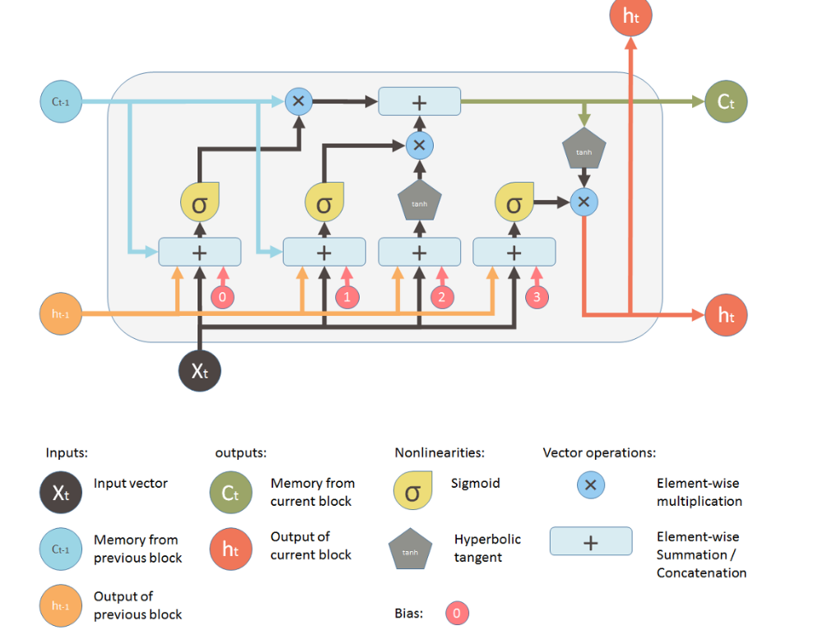
LSTM
$f_{t}$: forget gate, $I_{t}:input gate, o_{t}:output gate$
Taken from Chris Olah’s Blog post:

Slide 12
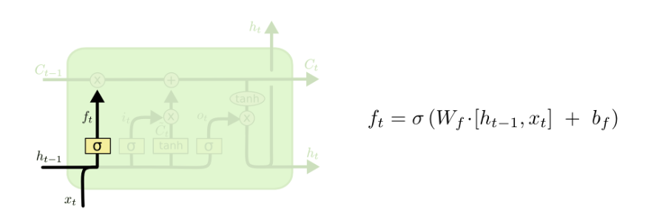
LSTM
Forget Gate
Taken from Chris Olah’s Blog post:
If ft=1, the previous cell state ct-1 willBe remembered. If ft=0, the
Previous state ct-1 will be forgotten

Slide 13
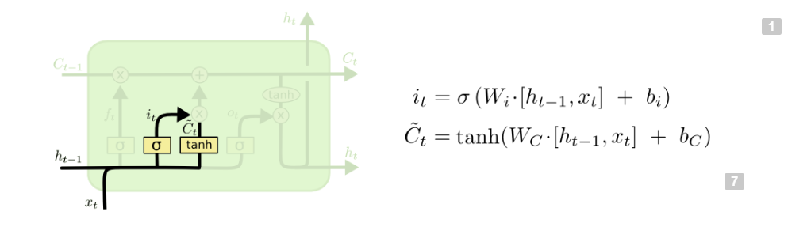
LSTM
Input gate, cell state
$$i_{t} controls the weight of the candidate cell state on the new cell state$$
$$c_{t}^{\sim } is added to C_{t−1} to obtain the new cell state$$

Slide 14
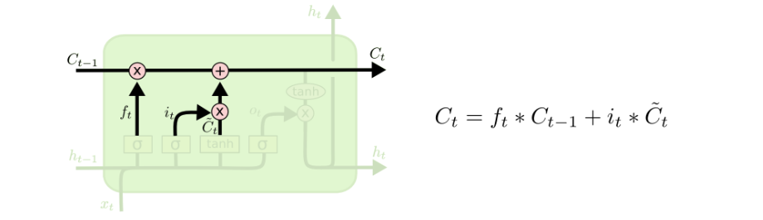
LSTM
Cell State
$$i_{t} controls the weight of the candidate cell state on the new cell state$$
$$f_{t} controls the weight of the old cell state on the new cell state$$

Slide 15
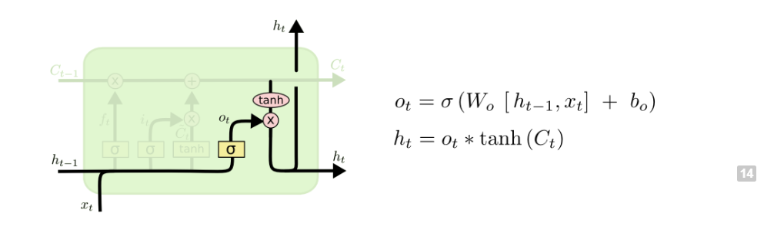
LSTM
$O_{t} is the weight muliplied by tanh(c_{t})$, the current cell state

Slide 16
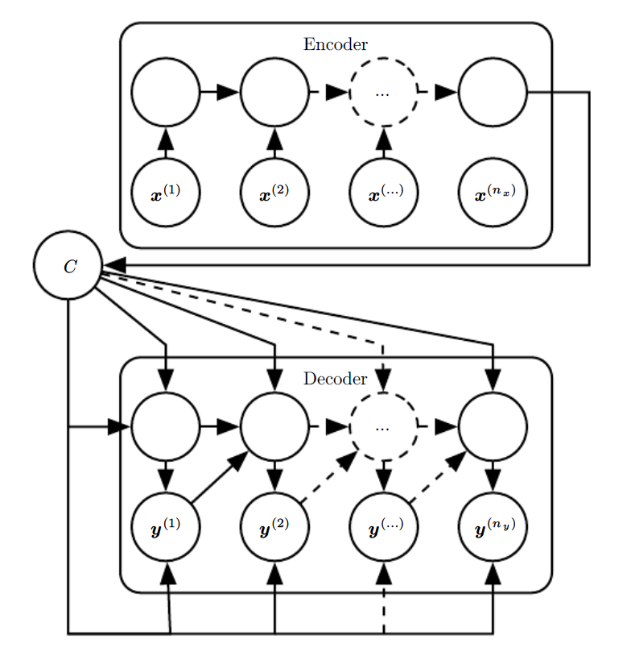
Sequence to Sequence Encoder Decoder Model
Used when input sequence and output sequence are of different length
Input RNN transmits input to a function C
C recreates the input to an output RNN
C compresses the input sequence and extracts essential features which are passed to the decoder
(Deep Learning, Ian Goodfellow)

Slide 17
Part A :Introduction
Objective: To use Fundamentals in combination with timeseries DL techniques for Stock Price Prediction
Performed for NYSE Oil & Gas Stock
3 Models compared: Multivariate Model, Bi-Variate Model, Uni-Variate Model.
Multi-Variate Model Features:-Returns_t, XOI. P/E ratio, P/B ratio, BVPS.
Bi-Variate model Feature:- Returns_t, XOI
Uni-Variate model Features: Returns_t
Training & Testing performed individually for every stock. If there are N stocks-> N models

Slide 18
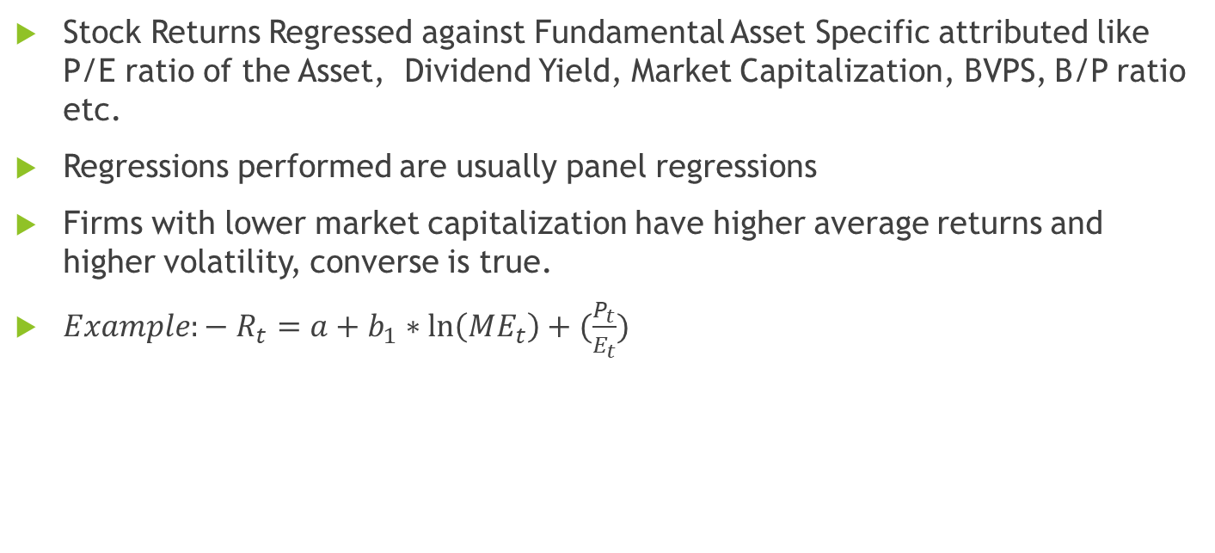
Fama –French Fundamental Factor Models
Stock Returns Regressed against Fundamental Asset Specific attributed like P/E ratio of the Asset, Dividend Yield, Market Capitalization, BVPS, B/P ratio etc.
Regressions performed are usually panel regressions
Firms with lower market capitalization have higher average returns and higher volatility, converse is true.
${Example:− R}_{t}=a+b_{1}∗\ln\left(ME_{t}\right)+(\frac{P_{t}}{E_{t}})$

Slide 19
Data Description
Stock Price Data obtained from Yahoo Finance
Fundamentals Data consists of Quarterly, Balance Sheet, Cash Flow and Income Statement (TTM)
Data obtained from XBRL filings and data from securities and exchange commission
Important features- P/E ratio
P/B ratio
Dividend Payout Ratio: Ratio of Dividend (TTM) to Earnings (TTM)

Slide 20
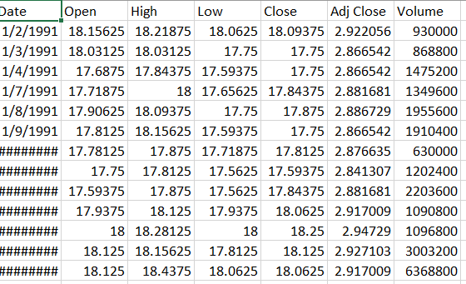
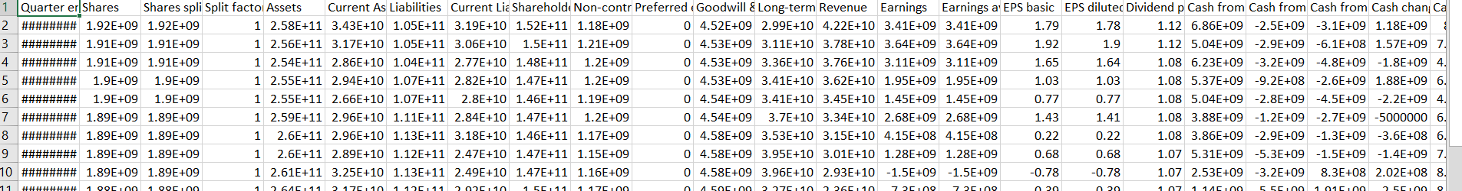
Data Description
Price Data (Daily Data)
Fundamentals Data (Quarterly Data)

Slide 21
Methodology
A daily Average price is calculated from the Price dataset from the Open, High, Low and Close Prices.
A Monthly Average price is calculated from this daily average price and the Price Dataset, including XOI are merged with the fundamentals dataset.
A Linear Interpolation is performed on the Fundamentals dataset to obtain monthly data for fundamentals.
A LSTM model is applied to the dataset. Iterations are performed over the model to choose the most Significant Predictors. This is called the Multivariate Model. Since the Total number of data points for 20 years is only 240 for a particular security, A large number of predictors cannot be selected for the Multivariate model.
Tuning and Optimization of hyperparameters and the number of hidden layers are performed.
Results of the Bi-Variate, Multi-Variate and Uni-Variate Model are compared

Slide 22
Code and Model Description
The Neural Network Model was created on Keras and Tensorflow. Python Libraries used for deep learning
Architecture to be tuned: Depth of the Network, Number of Nodes, in each layer, Number of LSTM layers.
Hyperparameters:-Bach Size, number of epochs, Dropout, Loss Function, Optimization Algorithm

Slide 23
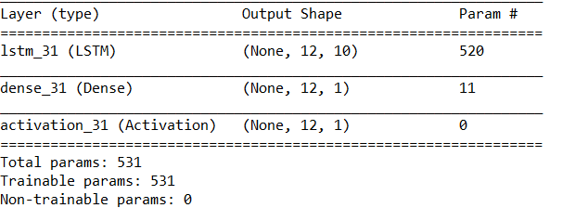
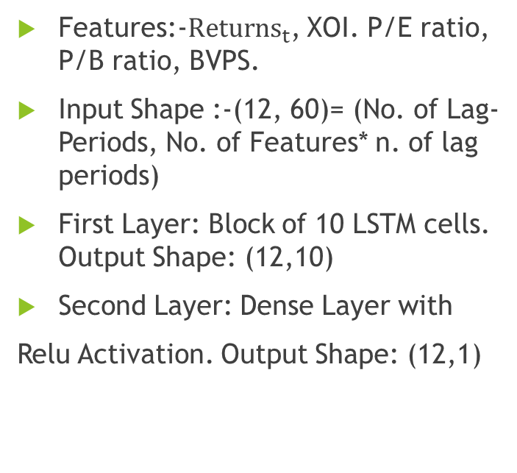
Multi-Variate Model
Features:-$Returns_{t}$, XOI. P/E ratio, P/B ratio, BVPS.
Input Shape :-(12, 60)= (No. of Lag-Periods, No. of Features* n. of lag periods)
First Layer: Block of 10 LSTM cells. Output Shape: (12,10)
Second Layer: Dense Layer with
Relu Activation. Output Shape: (12,1)
0

Slide 24
Results
Lesser Variabiliy seen on Securities with Market –cap> 5 billion
Supports Fama –French Theory

Slide 25
Results Summary
Mixed Results obtained from the Model
The Univariate model outperforms the Multivariate model 9/16 occasions
Unviariate Model outperforms Bivariate Model 8 /16 occasions
No conclusive results to show additional features improve prediction
%RMSE For Various Models
Security | Multivariate Model | Bi-Variate Model | Uni-Variate- Model | Market Cap (Millions)
DO | 11.8 | 58.5 | 16.9 | 1370
RDC | 72 | 4.3 | 33.5 | 1530
ESV | 55.1 | 47.2 | 33.5 | 1910
SWN | 70.9 | 77 | 60.3 | 2175
RRC | 37 | 75.9 | 72 | 2312
NFX | 20.4 | 32.8 | 52.9 | 3229
MUR | 37.2 | 13.5 | 40.6 | 4525
EQT | 71.4 | 94.8 | 54.6 | 4526
HP | 2.3 | 6.3 | 32.3 | 6065
NBL | 9.2 | 11.6 | 17.9 | 9840
PXD | 54.2 | 5.55 | 2.6 | 23133
OKE | 48 | 21.8 | 13.1 | 26747
OXY | 16.9 | 11.9 | 10 | 49046
EOG | 22 | 4 | 20.4 | 53641
CVX | 8.6 | 23.6 | 24.7 | 224668
XOM | 27.5 | 8 | 17.4 | 313453

Slide 26
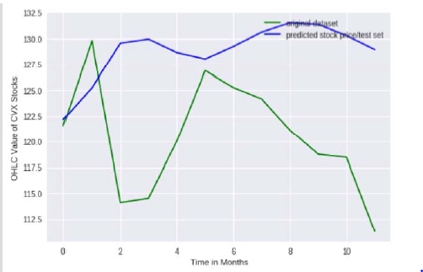
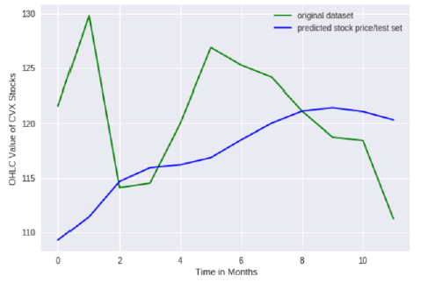
Plots: Chevron Energy (CVX)
Multivariate Model
Univariate Model
%RMSE = 8.6%
%RMSE = 24.7%

Slide 27
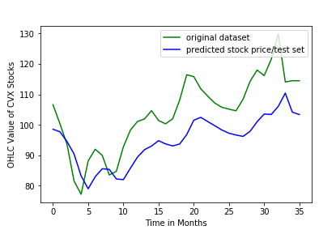
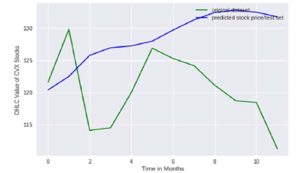
Plots: Chevron Energy (CVX)
Bivariate Model
Univariate Model 36 Months (48% RMSE)
%RMSE = 23.6%

Slide 28
Part B: Deep Learning and Portfolio Optimization
Objective: Select the best portfolio out of a set of all portfolios considered to Maximize Return/Earnings/Assets at least financial Risk.
Performed for NYSE S&P 100 companies.
Deep Learning used to Predict Stock Returns
Portfolio Optimization techniques used to choose optimum portfolio
Maximize Return at any level of Volatility.
One model single trained for N stocks together. This is used for Portfolio Selection
Part A: Portfolio optimization for Seen Data. Part B: Portfolio Optimization for Unseen Data.

Slide 29
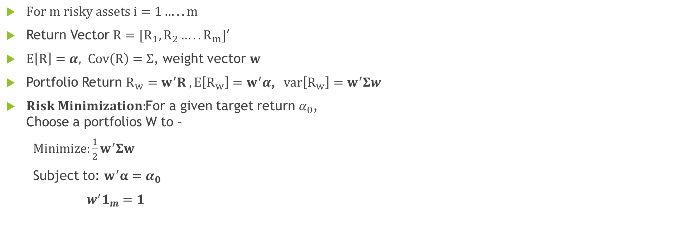
Markowitz Mean Variance Analysis
$For m risky assets i=1…..m$
Return Vector $R=[R_{1},R_{2}…..R_{m}]′$
$E\left[R\right]=α, Cov\left(R\right)=Σ$, weight vector $w$
Portfolio Return $R_{w}=w^{′}R , E\left[R_{w}\right]=w^{′}α$, $var\left[R_{w}\right]=w^{′}Σw$
$Risk Minimization:$For a given target return $α_{0}$, Choose a portfolios W to –
$Minimize:\frac{1}{2}w^{′}Σw$
Subject to: $w^{′}α=α_{0}$
$w^{′}1_{m}=1$

Slide 30
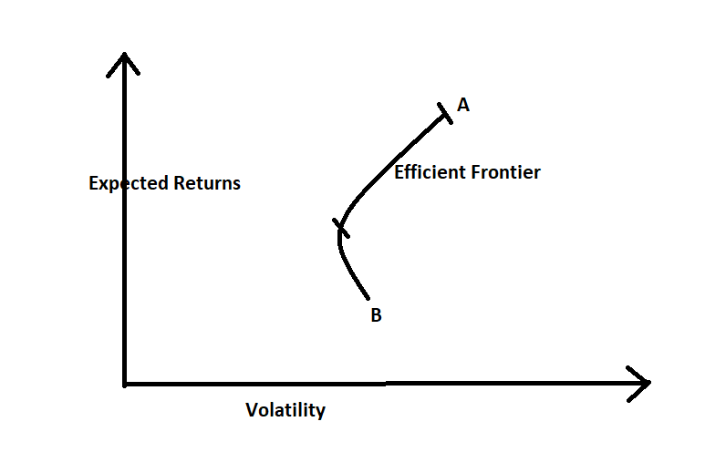
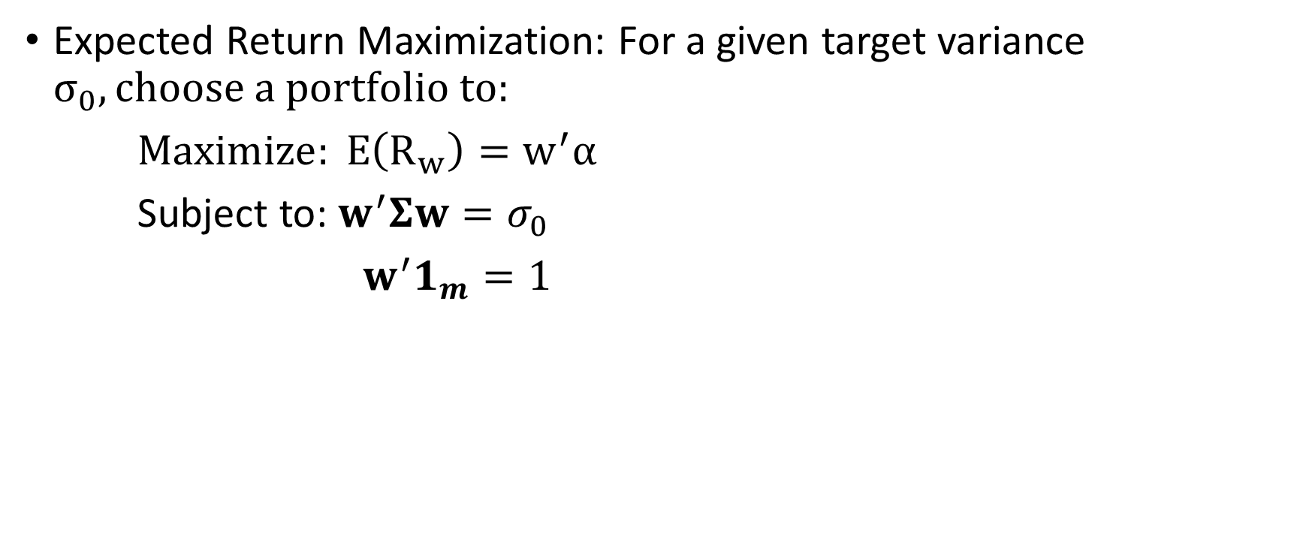
Markowitz Mean Variance Analysis
Expected Return Maximization: For a given target variance $σ_{0}, choose a portfolio to:$
$Maximize: E\left(R_{w}\right)=w^{′}α$
Subject to: $w^{′}Σw=σ_{0}$
$w^{′}1_{m}=1$
Portfolio of two assets

Slide 31
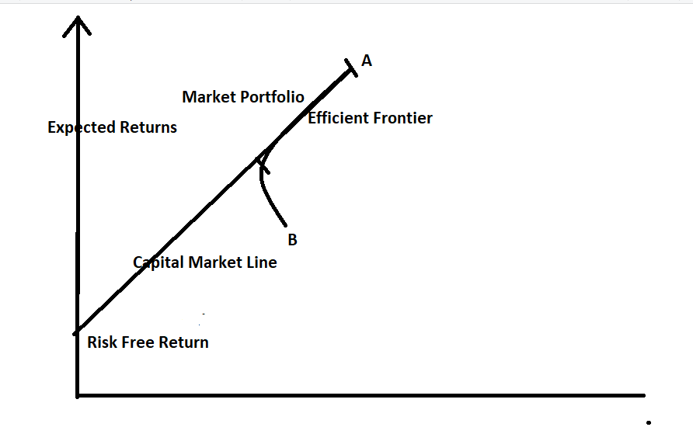
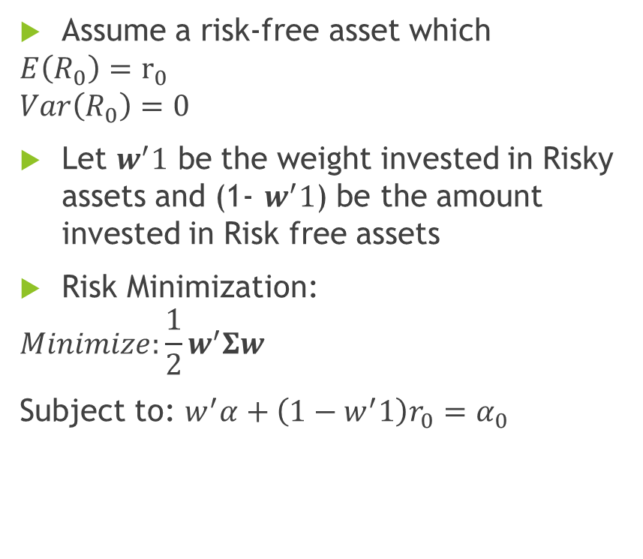
Portfolio Formation with Risk Free Asset
Assume a risk-free asset which
$$E\left(R_{0}\right)=r_{0}$$
$$Var\left(R_{0}\right)=0$$
Let $w^{′}1$ be the weight invested in Risky assets and (1- $w^{′}1$) be the amount invested in Risk free assets
Risk Minimization:
$$Minimize:\frac{1}{2}w^{′}Σw$$
Subject to: $w^{′}α+\left(1−w^{′}1\right)r_{0}=α_{0}$
Portfolio Formation with isk Free Return

Slide 32
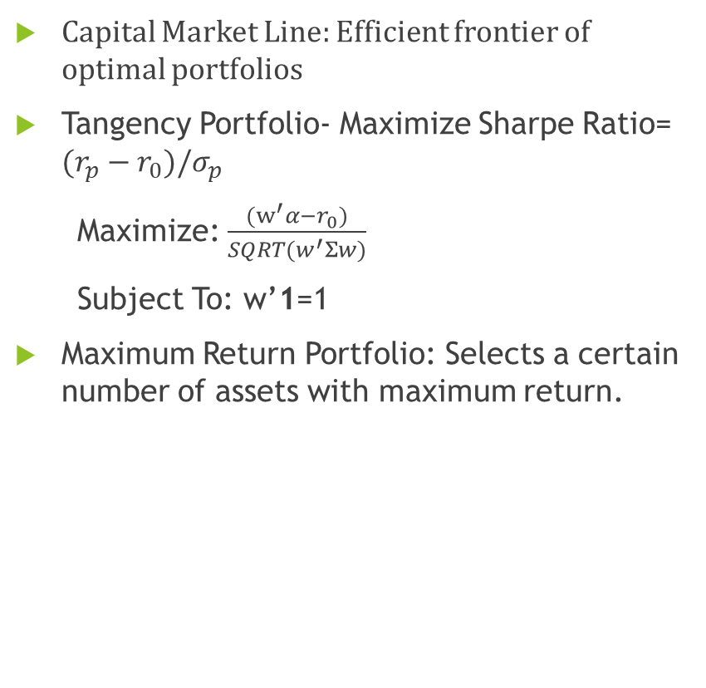
Capital Market Line (CML)
Capital Market Line: Efficient frontier of optimal portfolios
Tangency Portfolio- Maximize Sharpe Ratio= $(r_{p}−r_{0})/σ_{p}$
Maximize: $\frac{{(w}^{′}α−r_{0})}{SQRT(w^{′}Σw)}$
Subject To: w’1=1
Maximum Return Portfolio: Selects a certain number of assets with maximum return.
Volatility

Slide 33
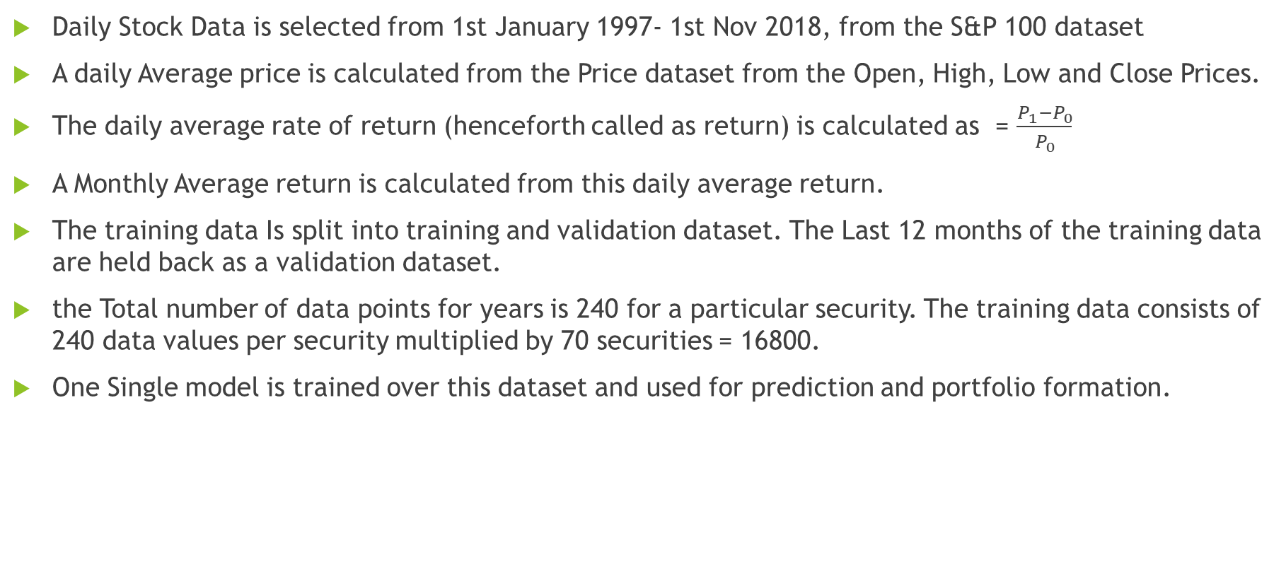
Portfolio Formation for S&P 100 Stock
Daily Stock Data is selected from 1st January 1997- 1st Nov 2018, from the S&P 100 dataset
A daily Average price is calculated from the Price dataset from the Open, High, Low and Close Prices.
The daily average rate of return (henceforth called as return) is calculated as = $\frac{P_{1}−P_{0}}{P_{0}}$
A Monthly Average return is calculated from this daily average return.
The training data Is split into training and validation dataset. The Last 12 months of the training data are held back as a validation dataset.
the Total number of data points for years is 240 for a particular security. The training data consists of 240 data values per security multiplied by 70 securities = 16800.
One Single model is trained over this dataset and used for prediction and portfolio formation.

Slide 34
Portfolio Formation for S&P 100 Stock
The Predicted Returns for 12 months are calculated for every Security using the LSTM Encoder-Decoder model.
The weights for four portfolios are calculated Markowitz portfolio, Tangency portfolio, maximal portfolio and the minimum variance portfolio.
The Returns are compared with the returns of S&P 100 Stock to evaluate portfolio performance

Slide 35
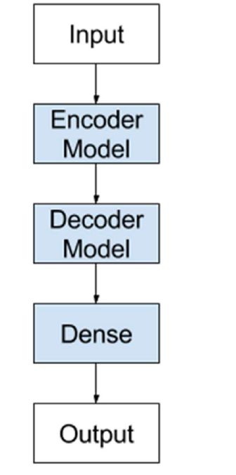
Model Description
Encoder-Decoder architecture consists of two models.

Slide 36
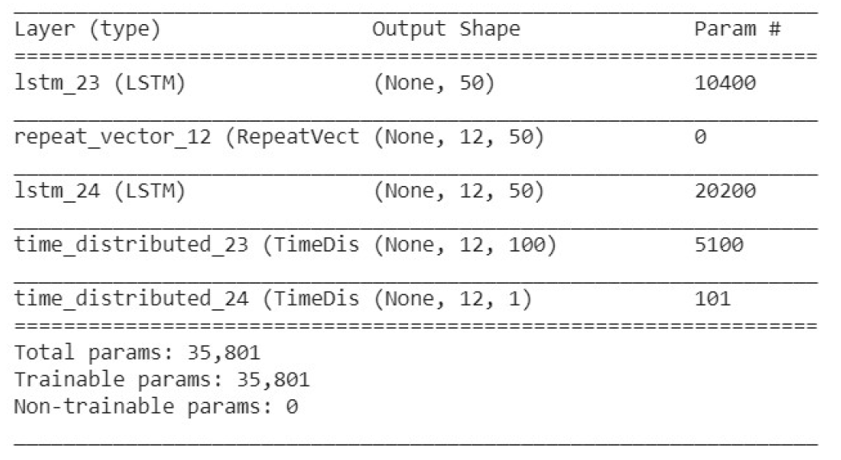
Model Description
LSTM23: creates a LSTM layer. This is the Encoder layer. It consists of 50 Memory cells.
Repeat-Vector: The encoder LSTM generates an 2D output of (None,50) – where 50 is the number of memory cells. The decoder LSTM requires a 3D input of [samples, time steps, features] in order to produce a decoded sequence, where the timesteps represents number of timesteps predicted ahead. The repeat vector operation converts the vector (None,50) into the 3D vector (None, 12,50) where 12 is the number of timesteps we are predicting in the future.

Slide 37
Model Description
LSTM24 – Decoder model. Outputs a 3D vector –(None, 12 50)
Time_distributed_23- Creates an output vector for every input. Receives an input of (None,12,50). Every time distributed layer (consisting of 100 nodes) creates an output of (None, 1, 100) for every input . Since the sequence consists of 12 inputs, the output of this layer is (None,12,100)
Time_distributed_24: consists of 1 node. Creates an output of (None, 12, 1) in a manner similar to that described above.

Slide 38
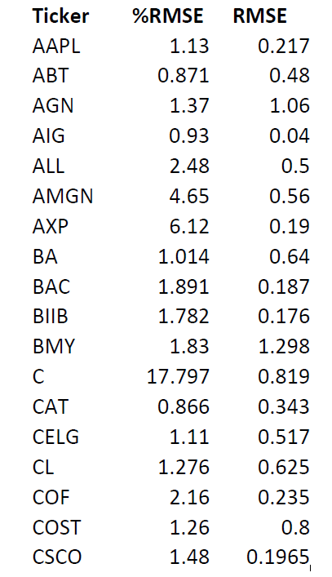
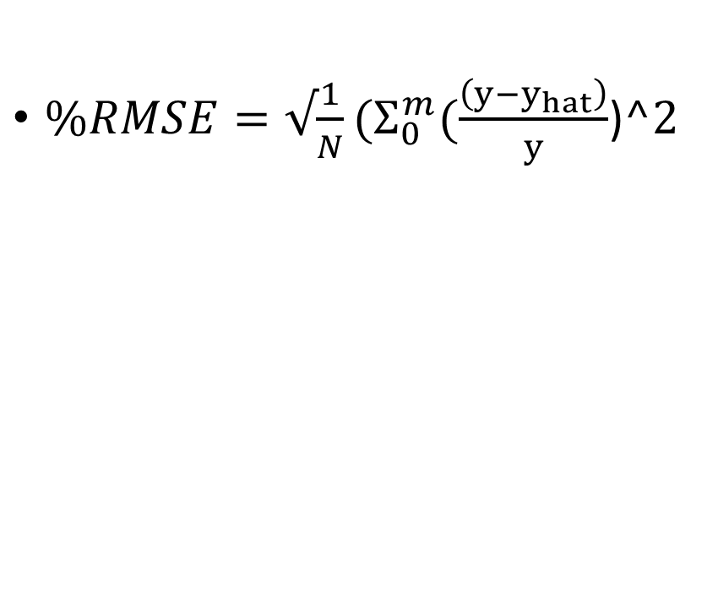
Results: Seen Data
$\%RMSE=√\frac{1}{N}(Σ_{0}^{m}(\frac{\left(y−y_{hat}\right)}{y}$)$^2$

Slide 39
Results: Seen Data
The annual actual Rate of
Return for all portfolios is higher than the S&P100 portfolio
 | Predicted Return | Actual Return | Annual Actual Return
Markowitz Portfolio | 0.012 | 0.0005 | 0.006
Tangency Portfolio | 0.0093 | 0.0002 | 0.0024
Markowitz Portfolio | 0.021 | 0.0004 | 0.0048
minimum Variance Portfolio | 0.023 | 0.0003 | 0.0036
S&P 100 | 0.000735 | 0.00019 | 0.00228

Slide 40
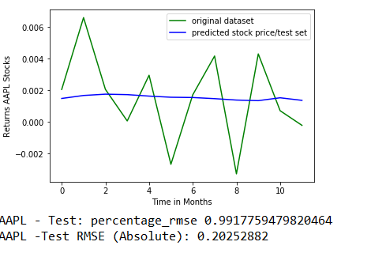
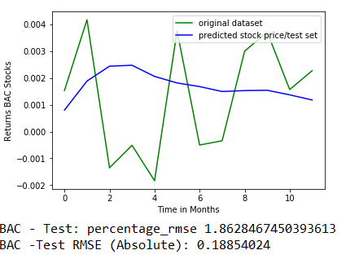
S&P 100: Plots (Seen Data)

Slide 41
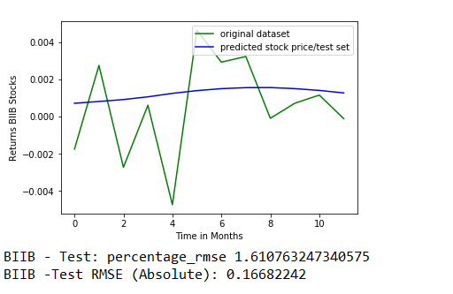
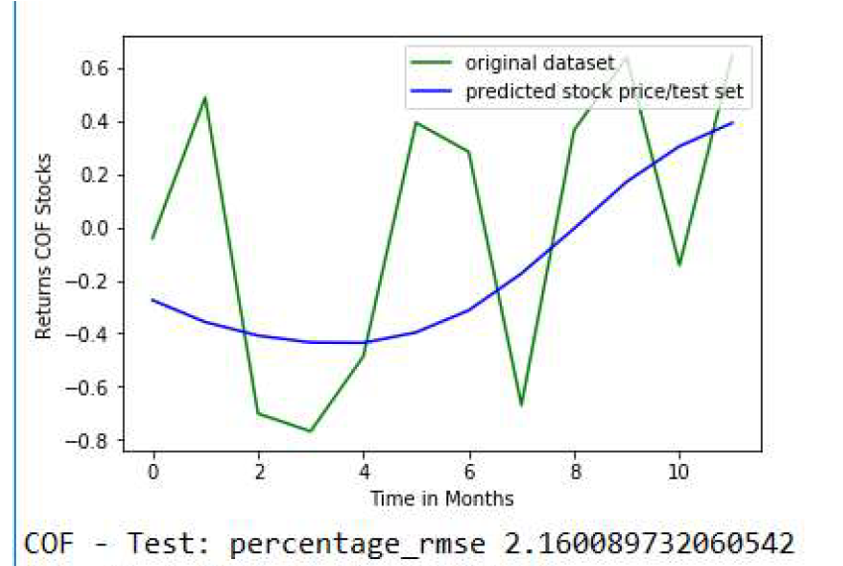
S&P 100 Plots: Seen Data

Slide 42
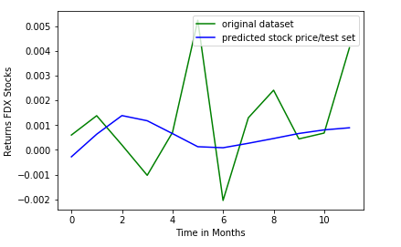
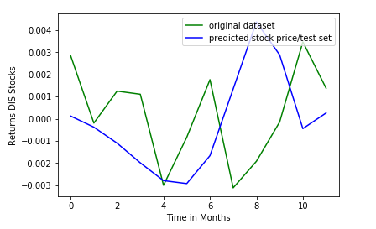
S&P100 plots: Seen Data

Slide 43
Portfolio Analysis on Unseen Data
The Model Trained on S&P 100 Stocks is used to predict returns outside the S&P 100 basket.
Model Predicts returns on Stock whose historical data it has not seen (trained on)
Predicted Returns of ‘Unseen Stock’ used to perform portfolio optimization. Markowitz portfolio, minimum variance portfolio,
Tangency portfolio created

Slide 44
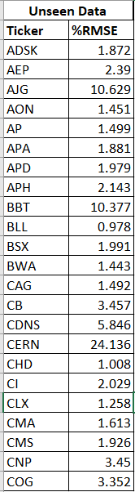
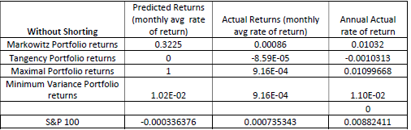
Results: Portfolio management on Unseen Data
From the above Data, we see that the returns from the Markowitz, maximal and minimum variance portfolios, outperform the S&P 100 portfolio.

Slide 45
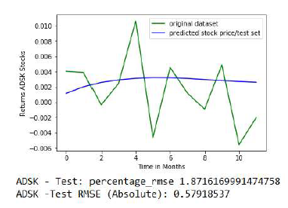
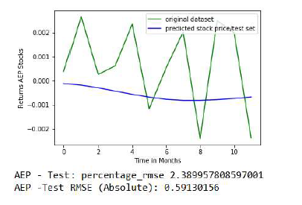
Plots: Portfolio Management on Unseen Data

Slide 46
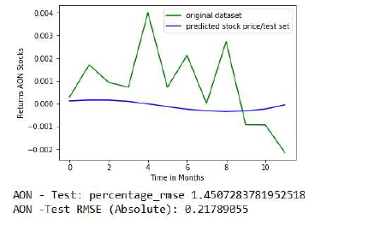
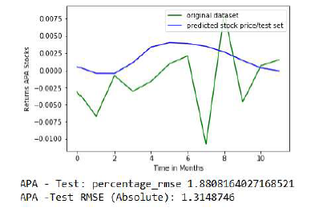
Plots: Portfolio Management on Unseen Data

Slide 47


Plots: Portfolio Management on Unseen Data

Slide 48
Conclusion
Portfolios of Predicted returns outperform S&P 100 portfolio
(Alberg,Lipton) MSE on predicted Returns =0.61
The Encoder-Decoder LSTM model predicts mean behavior of Stock over a period of time, making it ideal for portfolio selection

